Slide 1

Complex Data Types
Md shahidul salim (shakib)
Lecturer, cse, kuet

Slide 2
Your best quote that reflects your approach… “It’s one small step for man, one giant leap for mankind.”
- Neil Armstrong

Slide 3
Complex data types overview
One of the key requirements of the relational model is that data values be atomic: multivalued, composite, and other complex data types are disallowed by the core relational model.
However, this constraint can create problems for some applications.
The chapter explores several non-atomic data types that are commonly used in various applications, including semi-structured data, object-based data, textual data, and spatial data.

Slide 4
Semi-structured Data
Relational database designs have tables with a fixed number of attributes, each of which contains an atomic value. Changes to the schema, such as adding an extra attribute, are rare events
However, there are many application domains that need to store more complex data, whose schema changes often.
One real-life example of a complex data schema can be seen in an e-commerce website that allows users to create a profile and make purchases. The user profile may contain attributes like name, address, payment information, order history, and saved items. Each of these attributes may have nested attributes or complex data types. For instance, the "payment information" attribute may store multiple credit cards, each with its own set of data fields, such as card number, expiration date, and security code.
Furthermore, the "order history" attribute may contain a list of past orders, each with its own set of nested attributes, such as order date, shipping address, item list, and payment status. The "item list" attribute may contain a list of products, each with its own set of data fields, such as product name, description, price, and image.

Slide 5
Overview of Semi-structured Data Models
Semi-structured data refers to data that does not follow a strict data model, such as a relational database, but still has some structure that allows it to be queried and analyzed.
This type of data is often used in applications where the data schema changes frequently, or where the data itself is unstructured or loosely structured, such as web pages, JSON documents, or XML documents.
The relational data model has been extended in several ways to support the storage and data exchange needs of modern applications.
Flexible Schema
Multivalued Data Types
Nested Data Types
Knowledge Representation

Slide 6
Flexible Schema
Flexible schema refers to a data model that allows for changes to the schema without requiring significant modifications to the database structure or existing data.
In contrast to a rigid or fixed schema, which requires predefined data types and structure for all data, a flexible schema allows for more dynamic and fluid data models that can adapt to changing business requirements.
Flexible schema is particularly useful in applications where the data schema changes frequently or where the data itself is unstructured or semi-structured.
For example, in a social media platform, user-generated content such as posts, comments, and likes may have a constantly evolving data schema as new features and functionality are added.

Slide 7
Multivalued Data Types
Multivalued data types are data types that can hold multiple values within a single attribute or field.
In a relational database, a single attribute is typically restricted to hold only one value, such as a single number, string, or date.
However, in some cases, a single attribute may need to hold multiple values, such as a list of phone numbers or a set of skills.
Multivalued data types are used to represent such data, and they come in different forms depending on the data model and database system being used.
For example, in a relational database, multivalued attributes can be represented using a separate table that links to the original table using a foreign key. In this approach, each value in the multivalued attribute is stored in a separate row of the linked table.
Another approach to representing multivalued data is through nested data structures in document-oriented databases or JSON documents. In this approach, the multivalued attribute is represented as an array or list of values within a single document.

Slide 8
Multivalued Data Types
Many data representations allow attributes to contain non-atomic values. Many databases allow the storage of sets, multisets, or arrays as attribute values.
For example, an application that stores topics of interest to a user, and uses the topics to target articles or advertisements to the user, may store the topics as a set.
An example of such a set may be: { basketball, La Liga, cooking, anime, Jazz }
A key-value map, often just called a map, is a set of (key, value) pairs, such that each key occurs in at most one element.
For example, e-commerce sites often list specifications or details for each product that they sell, such as brand, model, size, color, and numerous other product-specific details.
{ (brand, Apple), (ID, MacBook Air), (size, 13), (color, silver) }

Slide 9
Nested Data Types
An attribute name may have component attributes firstname, and lastname.
These representations also support multivalued data types such as sets, arrays, and maps.
All of these data types represent a hierarchy of data types, and that structure leads to the use of the term nested data types.
JavaScript Object Notation (JSON) and the Extensible Markup Language (XML) allow values to have complex internal structures and that are flexible in that values are not forced to adhere to a fixed schema.
The JSON and XML representations permit a more flexible structuring of data, where objects could have sub-objects; each object thus corresponds to a tree structure.

Slide 10
Knowledge Representation
Representation of human knowledge has long been a goal of the artificial intelligence community.
A variety of models were proposed for this task, with varying degrees of complexity.
With the growth of the web, a need arose to represent extremely large knowledge bases, with potentially billions of facts.
The Resource Description Format (RDF) data representation is one such representation that has found very wide acceptance.
The representation actually has far fewer features than earlier representations, but it was better suited to handle very large data volumes than the earlier knowledge representations.

Slide 11
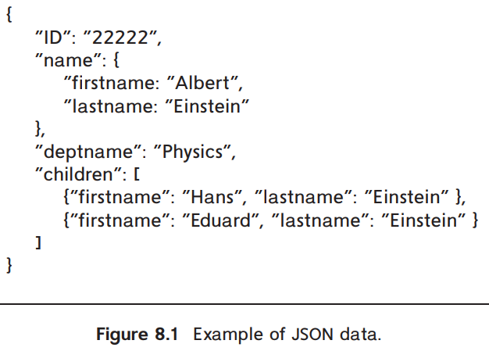

JSON
The JavaScript Object Notation (JSON), is a textual representation of complex data types that is widely used to transmit data between applications and to store complex data. JSON supports the primitive data types integer, real and string, as well as arrays, and “objects,” which are a collection of (attribute name, value) pairs.

Slide 12
JSON
Figure 8.1 shows an example of data represented using JSON.
Since objects do not have to adhere to any fixed schema, they are basically the same as key-value maps, with the attribute names as keys and the attribute values as the associated values.
The example also illustrates arrays, shown in square brackets. In JSON, an array can be thought of as a map from integer offsets to values, with the square-bracket syntax viewed as just a convenient way of creating such maps.
JSON is today the primary data representation used for communication between applications and web services.

Slide 13

XML
XML stands for eXtensible Markup Language. It is a markup language that defines a set of rules for encoding documents in a format that is both human-readable and machine-readable. XML was designed to be a versatile and platform-independent format for storing and exchanging structured data.
The XML data representation adds tags enclosed in angle brackets, <>, to mark up information in a textual representation.
Tags are used in pairs, with and delimiting the beginning and the end of the portion of the text to which the tag refers.
For example, the title of a document might be marked up as follows:

Slide 14
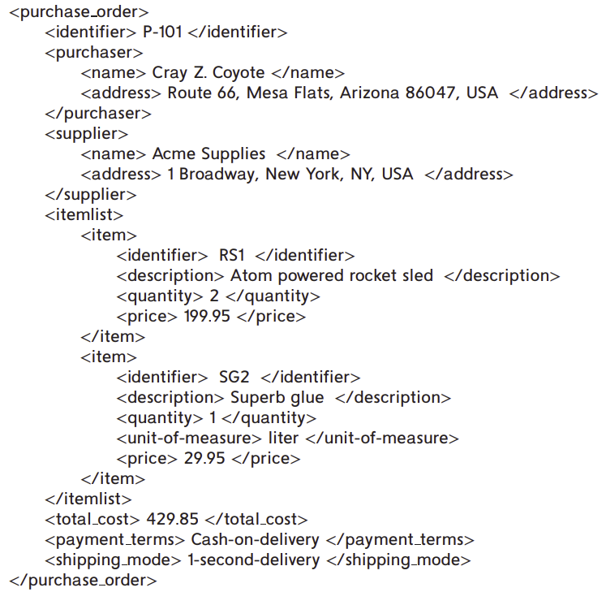
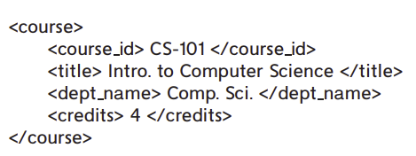
Representing relational data specifying relation names and attribute names as tags
Figure shows how information about a purchase order can be represented in XML, illustrates a more realistic use of XML.

Slide 15
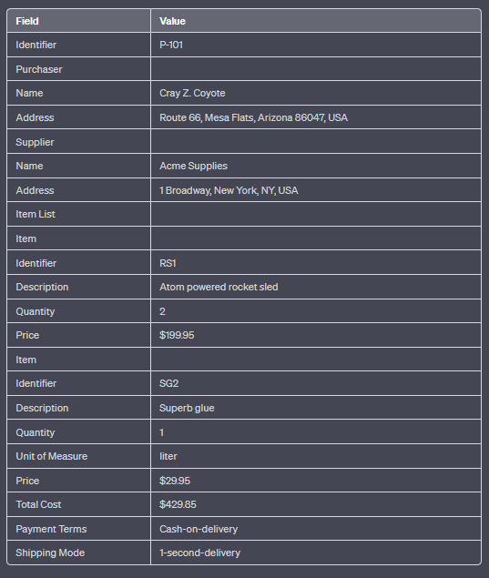

Slide 16
SQL language support XML
XML data can be stored as an XML data type.
SQL queries can generate XML data from relational data. Such extensions are very useful for packaging related pieces of data into one XML document, which can then be sent to another application. The extensions allow the construction of XML representations from individual rows, as well as the creation of an XML document from a collection of rows by using an XMLAGG aggregate function.
SQL queries can extract data from an XML data type value. For example, the XPath language supports “path expressions” that allow the extraction of desired parts of data from an XML document.

Slide 17
RDF and Knowledge Graphs and Triple Representation
The Resource Description Framework (RDF) is a data representation standard based on the entity-relationship model.
The RDF model represents data by a set of triples that are in one of these two forms:
1. (ID, attribute-name, value)
2. (ID1, relationship-name, ID2)
ID, ID1 and ID2 are identifiers of entities; entities are also referred to as resources in RDF. Note that unlike the E-R model, the RDF model only supports binary relationships, and it does not support more general n-ary relationships.
The first attribute of a triple is called its subject, the second attribute is called its predicate, and the last attribute is called its object. Thus, a triple has the structure (subject, predicate, object).

Slide 18
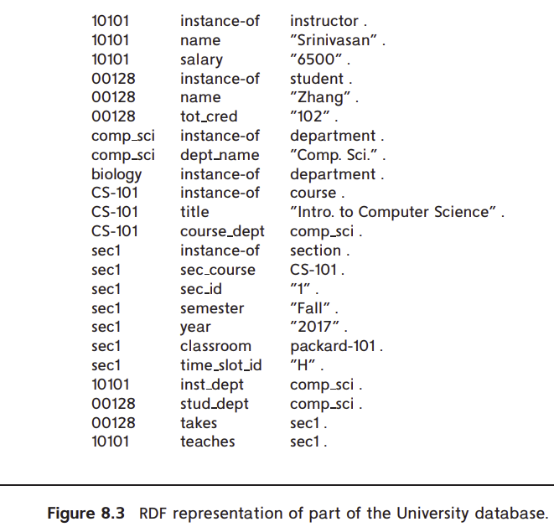
All attribute values are shown in quotes, while identifiers are shown without quotes. Attribute and relationship names (which form the predicate part of each triple) are also shown without quotes

Slide 19
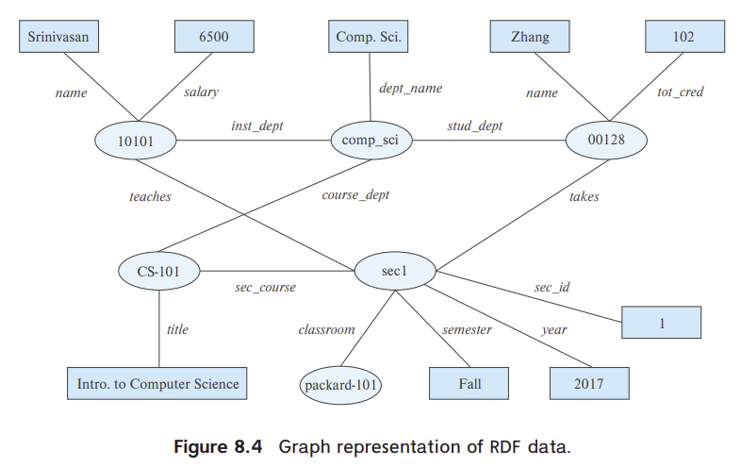
Graph Representation of RDF
Entities and attribute values can be considered as nodes, and attribute names and relationships can be considered as edges between the nodes.
The attribute/relationship name can be viewed as the label of the corresponding edge.
Figure 8.4 shows a graph representation of the data from Figure 8.3.
Objects are shown as ovals, attribute values in rectangles, and relationships as edges with associated labels identifying the relationship.

